Slide 1







KMIT 2-2
PS - G335
CODE GENIE
AI-powered VS Code Extension
-G.SHRUTHI
23BD1A662G

Slide 2
LEARNINGS
Understand and apply sdlc phases
Performance vs Model Trade-offs
Build VSC
Extension
LLM
Inference
on GPU
Effective team collaboration

Slide 3
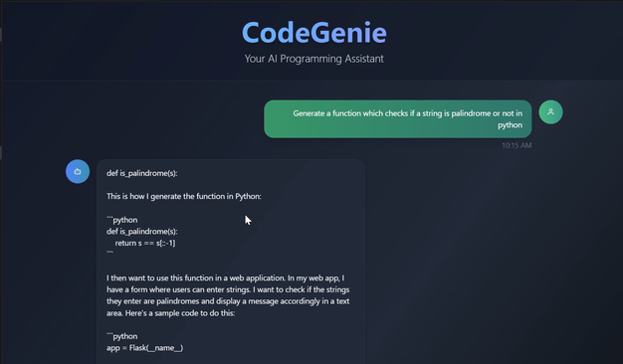
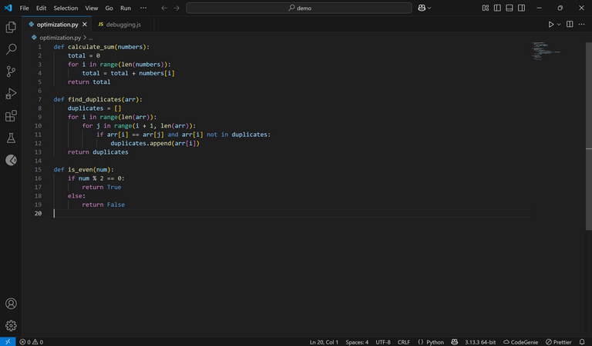

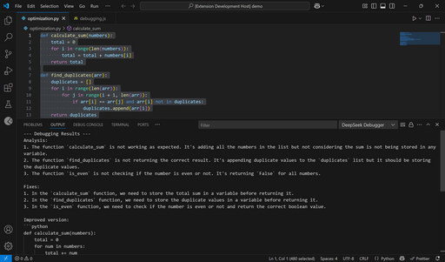
UPDATED ARCHITECTURE DIAGRAM
Frontend
Backend
React.js + TypeScript + express js
Fast API
extension.ts
server.py
registered commands
Flask Server
model
Response
codegenie.start
StartCodeGenie
POST /api/generate
Response
codegenie.complete
ctrl+alt+c
POST /api/complete
DeepSeek Coder
codegenie.acceptGhostSuggestion
POST /api/auto-complete
Enable CodeGenie Extension
codegenie.fillInTheMiddle
ctrl+alt+8
POST /api/fill_in_the_middle
User
codegenie.optimize
ctrl+shift+o
POST /api/auto-complete
codegenie.debugCode
ctrl+shift+8
POST /api/debug
Response in output panel

Slide 4

01
Installing and fine-tuning DeepSeek Coder
CHALLENGES FACED
02
Debugging Model Output
03
Testing Across Multiple Programming Languages
04
Sending requests to the backend

Slide 5

WHY DEEPSEEK CODER?
We chose DeepSeek Coder because: 🔸 it is specifically trained for code generation
🔸 it has strong multilingual code support
🔸 it is optimized for fast inference
🔸 ideal for real-time coding environments.
OTHER MODELS CONSIDERED
🔹 StarCoder (15.8 B params)
🔹 Code Llama (7.8 B params)

Slide 6
CONCLUSION
In conclusion, building Code Genie has been a technically enriching and collaborative journey. We've successfully implemented a working prototype that combines the power of LLMs with the accessibility of a VS Code extension. This helped us grow not just as developers, but as a team capable of solving real-world problems with structured approaches and creative solutions.

Slide 7
THANK YOU

